Slide 1
Intercept X Early Access Program July 2017
Karl Ackerman
Principal Product Manager – Endpoint Security Group
July 2017

Slide 2
Joining the Early Access Program
Open to ALL Sophos Central Customers including Trial Accounts
Supports Windows 7 Devices and above

Slide 3
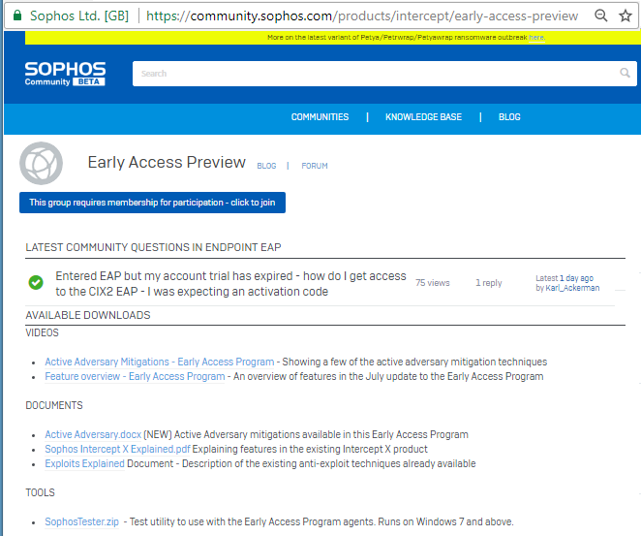
Community Forum
Join the Sophos Community
Post questions to Sophos product experts
Access additional demonstration videos
Articles explaining features in depth
Testing tools
https://community.sophos.com/products/intercept/early-access-preview/

Slide 4
Early Access Program Feature Summary
Phase I - Active Adversary
Phase II – Deep Learning
Credential Theft Protection
Process Protection
New Registry Protections
Improved Process Lockdown
Deep Learning Model
False Positive Mitigations
Directed Clean-Up

Slide 5
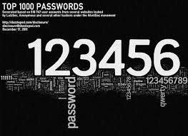
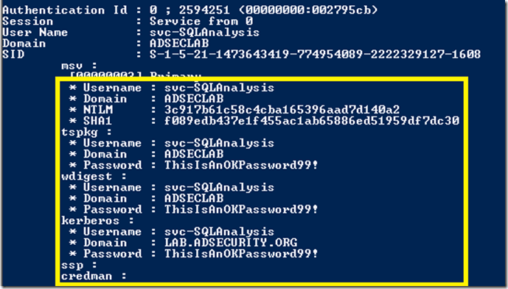
Credential Theft Protection
Phase I - Active Adversary
Adversary is attempting to steal passwords
Impersonate the end user
Move laterally through the network
Establish persistence
Exfiltration of data available to the compromised account
Multiple hacking/penetration tools available
Mimikatz, Hashdump
Adversary can steal password hashes and crack them on-line
Adversary can extract clear text PWs from memory
Target the technique not the tool
Protect LSASS runtime memory
Protect SAM DB Registry
Protect Disk sectors with hash information

Slide 6
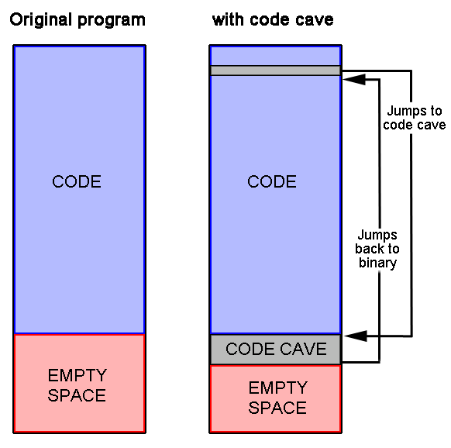
Code Cave Utilization
Phase I - Active Adversary
Adversary hides malware in a legitimate application
Tricks user to think they have good software
Can be used to replace business applications with tampered versions
Malware can hide in “plain sight” and can even get whitelisted by traditional security
Common practice in penetration and hacking
Multiple tools available to inject into target applications; Shelter, back door factory, etc
Target the technique not the tools
Detect unauthorized code cave content

Slide 7
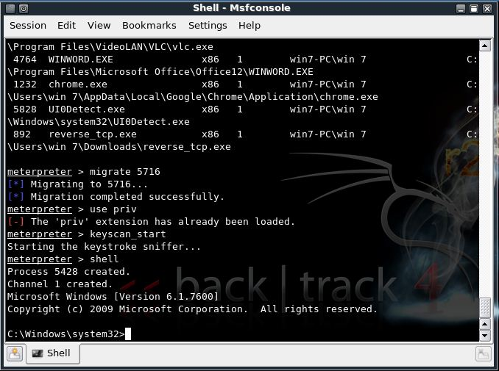
Process Protection – Malicious Process Migration
Phase I - Active Adversary
Adversary “stays on the move” and avoids detection
Process migration allows the adversary to move from one compromised process to another
Maintains connection even when user terminates the browser session
Common practice in penetration and hacking
Basic capability in Metasploit and other pen test tools
Typically leverages DLL injection exploits
Target the technique not the tools
Detect unauthorized process migration

Slide 8
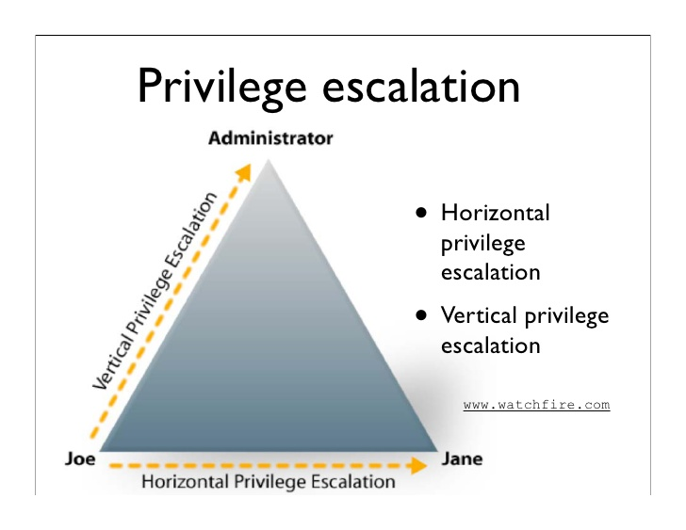
Process Protection – Process Privilege Escalation
Phase I - Active Adversary
Adversary hijacks machine to gain privilege escalation and elevated access to resources
Escalation of a process privilege or changing process owner
Gain access to restricted files/folder or devices
Multiple Kernel vulnerabilities
Allow process ticket theft and reuse
Easily run from scripts in penetration test tools
Often just a step in a process to reach a more sophisticated objective
Target the technique not the tools
Detect kernel token theft and reuse

Slide 9
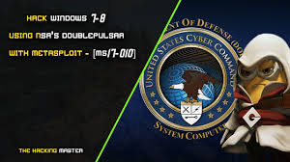
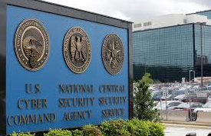
Process Protection – APC Violation
Phase I - Active Adversary
*NEW* Exploit Techniques
Leverages malicious Asynchronous Procedure Calls
Develop a worm to propagate between unprotected machines
Exploit vulnerability to run arbitrary code
Multiple hacking/penetration tools available
Fully weaponized by criminal syndicates
Available in multiple exploit kits
WanaCry and Petya ransom attacks
Target the technique not the tools
Detect malicious APC usage

Slide 10
Process Protection – Registry Protection
Phase I - Active Adversary
Modification of Registry to run arbitrary code
Uses legitimate registry options to launch code
Application Verifier registry option
Sticky key attack (Old school)
Often used to establish persistence
Well documented and easy to use
Simple registry modifications are easily deployed on compromised machines
Tools to make it even easier are online
Target the technique not the tools
Prevent arbitrary code launch via common registry modification techniques

Slide 11
Process Protection – Process Lockdown
Phase I - Active Adversary
Adversary uses legitimate capabilities for malicious intent
NO MALWARE needed in the attack
“Live off the land” attacks leverage existing system features
Commonly used on locked down systems
Extremely common (i.e., Enable Macros, etc)
Trick user to allow risky behavior
Target the known malicious behaviors
Extending an existing feature in intercept X
Prevent malicious launch of powershell from browser
Enforce browser lockdown feature to HTML applications run through the browser

Slide 12
Invincea – Machine Learning Experts
Phase II – Deep Learning
Created by the data scientists at Invincea with DARPA driven technology
Patented Deep Learning neural networks trained on 50+ million samples (and counting)
which can also automatically learn to extract the features that provide optimal detection
Stops unknown malware without signatures
Some of the highest performance scores ever seen in third party testing with lowest FP’s in class
Detects and stops threats within 20 milliseconds
Deep Learning Detection Engine
Notes:
Poll audience understanding of ML – if weak talk to section 1, if not jump to 2
1:
Machine learning is the science of getting computers to act without being explicitly programmed.
Artificial Intelligence that leverages pattern recognition, machines can learn from inputs and make predictions on data as opposed to static algorithms.
Resulting in the ability to make real-time data driven predictions or decisions through building a model from comprehensive real-time input.
How does this apply to Security?
Higher detection & prevention
Faster performance
2:
Machine Learning, Neural Networks and AI; is it really just the math?
No – it’s about teaching the right ML systems with the right data (features)...
…and creating systems that can go beyond features themselves
Patented Deep Learning neural networks trained on 50+ million samples (and counting)
Which can also automatically learn to extract the features that provide optimal detection
Created by the data scientists at Invincea with DARPA driven technology
Detects and stops threats within 20 milliseconds
Low footprint and infrequent model updates (once every ~50 days)
With the right SNR
By adding Invincea’s world-class pre-execution machine learning, with Sophos’ post-execution exploit protection, Ransomware behavior detection and analytics features we will have the most complete endpoint offering

Slide 14
Early Access Program Feature Summary
Phase I - Active Adversary
Phase II – Deep Learning
Credential Theft Protection
Process Protection
Code cave utilization
Malicious process migration
Process privilege escalation
APC protection (Atom bombing)
New Registry Protections
Sticky key protection
Application verifier protection
Improved Process Lockdown
Browser behaviour lockdown
HTA application lockdown
Deep Learning Model
Detect malicious and potentially unwanted executables
False Positive Mitigations
Whitelisting
Directed Clean-Up
Quarantine and restore capability

Slide 15
Intercept X EAP – Phase One: Active Adversary
Credential Theft Protection
Active Adversary protections
Code Cave prevention
Malicious Process Migration
Process privilege escalation
APC Filter (prevent Atom Bombing exploit variants)
Improved Application Lockdown
Powershell abuse from browsers
HTA apps
Prevent dumping of credentials from memory
Protect the credential database on Disk and Registry
Additional Registry Protections
Sticky Key Mitigation
Application Verifier Protection (Double Agent)

